Slide 1
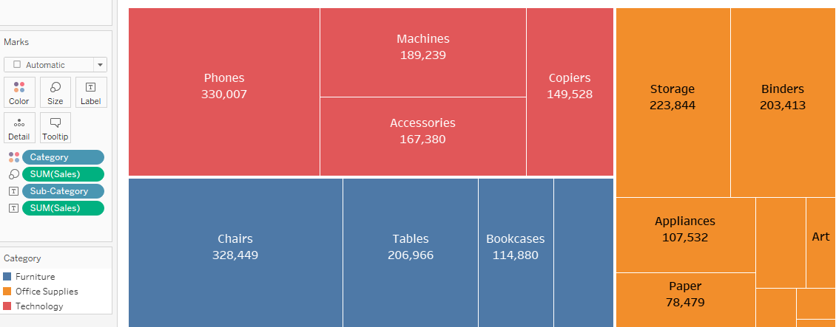
TREEMAP
A Treemap diagram is an appropriate type of visualization when the data set is structured in a hierarchical order with a tree layout with roots, branches, and nodes.
Treemaps are charts of colored rectangles, with size representing the values.
You use dimensions to define the structure of the treemap, and measures to define the size or color of the individual rectangles.
Treemaps are a relatively simple data visualization that can provide insight in a visually attractive format.

Slide 2
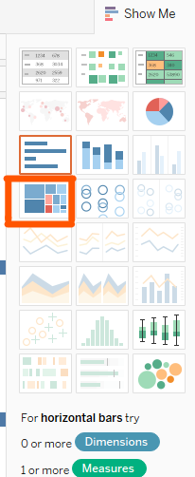
To create a treemap that shows total sales across sub-categories, follow are the steps below :
Connect to the Sample - Superstore data source.
Drag the Sub-Category dimension to Rows.
Drag the Sales measure to Columns.
By default, Tableau displays a bar chart—when there is a dimension on the Rows shelf and a measure on the Columns shelf.
4. Click Show Me on the toolbar, then select the treemap chart type.

Slide 3
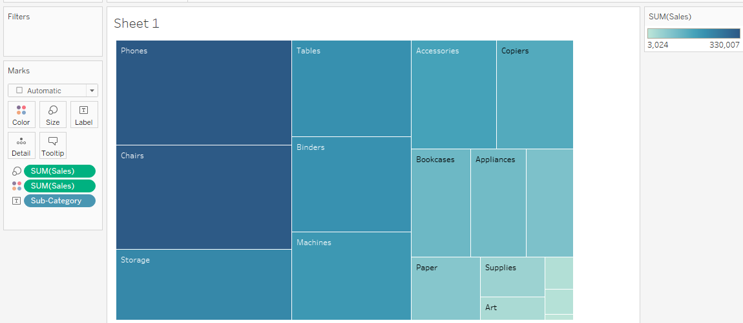
By default, Tableau showing Blue colors for chart.
In this treemap, both the size of the rectangles and their color are determined by the value of Sales—the greater the sum of sales for each sub-category, the darker and larger its box.

Slide 4
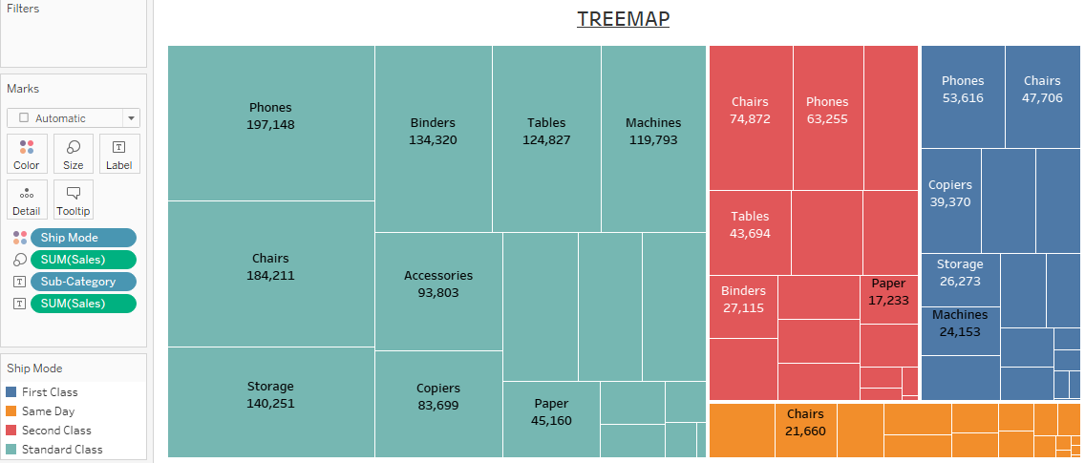
Drag the Ship Mode dimension to Color on the Marks card. In the resulting view, Ship Mode determines the color of the rectangles—and sorts them into four separate areas accordingly. Sales determines the size of the rectangles:

Slide 5
Why TREEMAP:
To display large amounts of hierarchical data.
When a bar chart can’t effectively handle the large number of values.
To show the proportions between each part and the whole.

